Slide 1
Knowledge Transfer and Adaptive Learning
Strategies in Reinforcement Learning
①
②
③
An Offline-Transfer-Online Framework for Cloud-Edge Collaborative Distributed Reinforcement Learning
Cross-Domain Adaptive Transfer Reinforcement Learning Based on State-Action Correspondence
Domain Adaptation In Reinforcement Learning Via Latent Unified State Representation
⑤
④
Reinforcement Learning With Adaptive Policy Gradient Transfer Across Heterogeneous Problems
Lateral Transfer Learning for
Multiagent Reinforcement Learning
CPS Computational Learning Laboratory

Slide 2

②
Cross-Domain Adaptive Transfer Reinforcement Learning Based on State-Action Correspondence
Learning State-Action
Correspondence
Decompose State Feature
①
③
An Offline-Transfer-Online Framework for Cloud-Edge Collaborative Distributed Reinforcement Learning
Domain Adaptation In Reinforcement Learning Via Latent Unified State Representation
Agenets with Different Policy Networks
Adaptive Grandient Transfer
⑤
④
Reinforcement Learning With Adaptive Policy Gradient Transfer Across Heterogeneous Problems
Lateral Transfer Learning for
Multiagent Reinforcement Learning
CPS Computational Learning Laboratory

Slide 3

Paper 1
An Offline-Transfer-Online Framework for
Cloud-Edge Collaborative Distributed Reinforcement Learning
Tianyu Zeng, Xiaoxi Zhang, Jingpu Duan, ChaoYu, Chuan Wu, XuChen
Published in: IEEE TRANSACTIONS ON PARALLEL AND DISTRIBUTED SYSTEMS
Published Time: 2024
CPS Computational Learning Laboratory

Slide 4
01
Problem Description
02
Method Design
03
Experiment Results
Contents
04
Conclusion
CPS Computational Learning Laboratory

Slide 5
01
Problem Description
02
Method Design
03
Experiment Results
Contents
04
Conclusion
CPS Computational Learning Laboratory

Slide 6
Problem Description
Cloud-edge collaborative artificial intelligence service with evolved DRL agents can be a significant scenario.
However, agents with different algorithms and architectures in the same DRL scenario may not be compatible, and training them is either time-consuming or resource-demanding.
CPS Computational Learning Laboratory

Slide 7
01
Problem Description
02
Method Design
03
Experiment Results
Contents
04
Conclusion
CPS Computational Learning Laboratory

Slide 8
Method Design
We design a novel cloud-edge collaborative DRL training framework, named Offline-Transfer-Online, which is a new approach that can speed up the convergence of online DRL agents at the edge by interacting with offline agents in the cloud.
At the core subroutine of OTO, our designed algorithm independent knowledge distillation (AIKD) strategy is a novel transfer learning approach for boosting the Q value learning .
We propose several simple but effective techniques to augment the DRL architecture
Extend the RKD(Relational Knowledge Distillation) to be compatible with discrete actions
We also design a fusion-policy architecture to address that problem that Q-value based DRL implementation can not be directly applied into on-policy RL.
CPS Computational Learning Laboratory

Slide 9
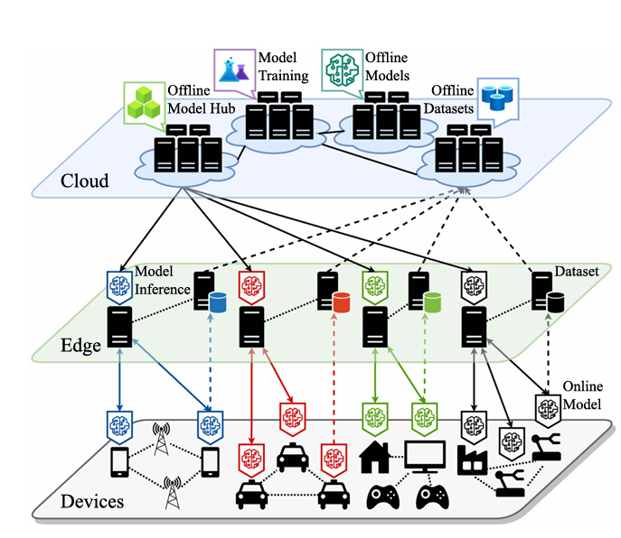
Method Design
Cloud: Training offline agents using offline data
Edge: Training online agents through action inference of offline agents
CPS Computational Learning Laboratory

Slide 10
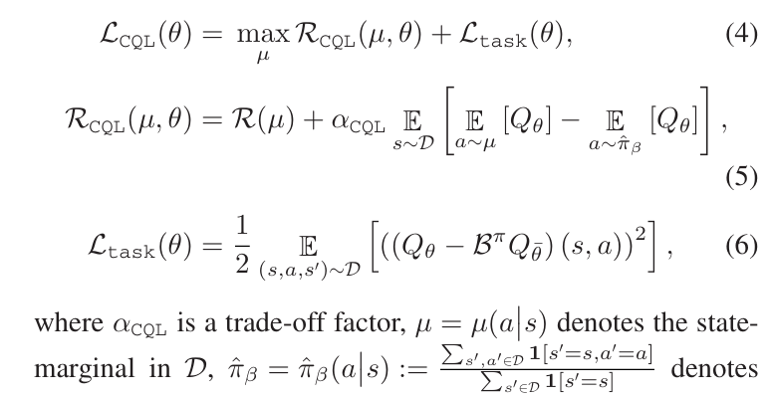
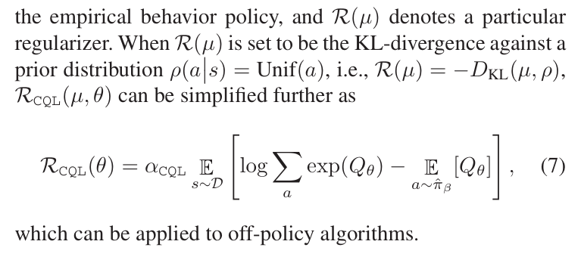
Method Design
Conservative Q-learning(CQL) for offline reinforcement learning
CPS Computational Learning Laboratory
Notes:
CQL：保守强化学习，主要解决模型对未见过动作的价值过估计问题，通过在损失函数中加入L_CQL约束项实现
公式7是对公式5中最大动作价值进行了一个近似

Slide 11
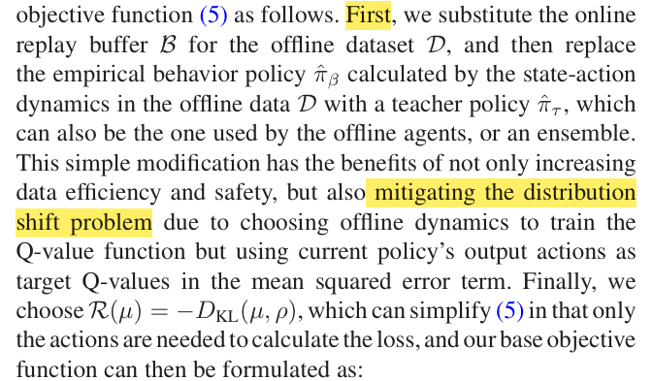
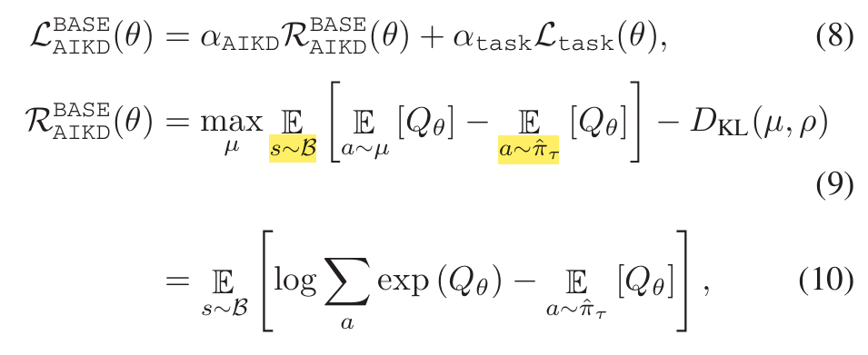
Method Design
AIKD for Online Reinforcement Learning
CPS Computational Learning Laboratory
Notes:
用离线数据训练在线智能体，存在分布偏移问题，导致动作对Q值未见过动作价值估计不准确，且泛化能力差（离线数据和在线环境不匹配）

Slide 12
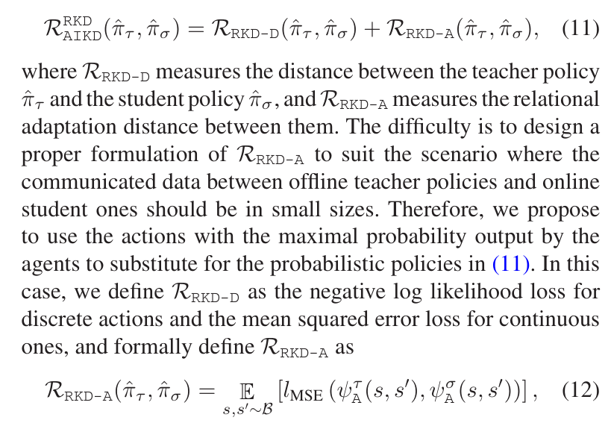
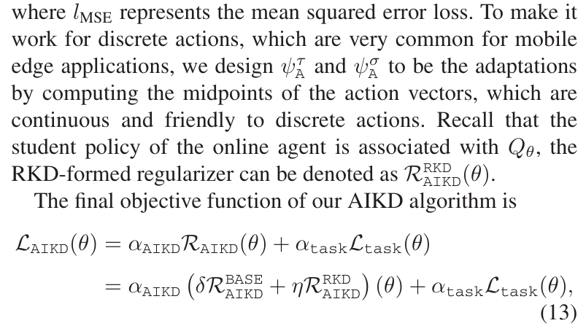
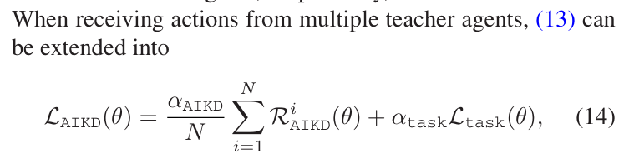
Method Design
AIKD for Online Reinforcement Learning
CPS Computational Learning Laboratory
Notes:
定义迁移蒸馏损失，

Slide 13
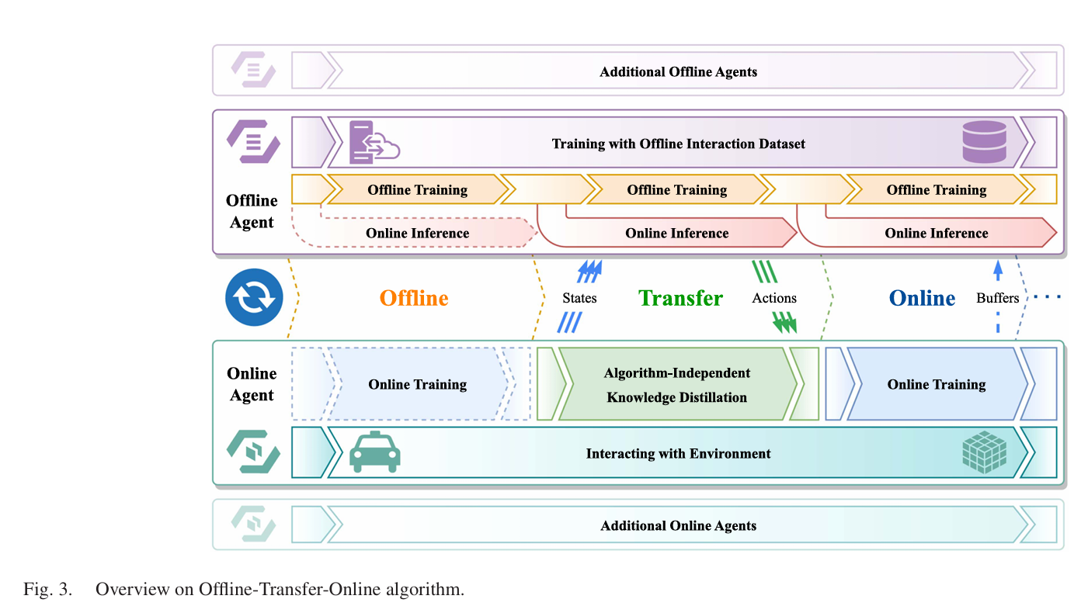
Method Design
Offline-Transfer-Online Reinforcement Learning
CPS Computational Learning Laboratory

Slide 14
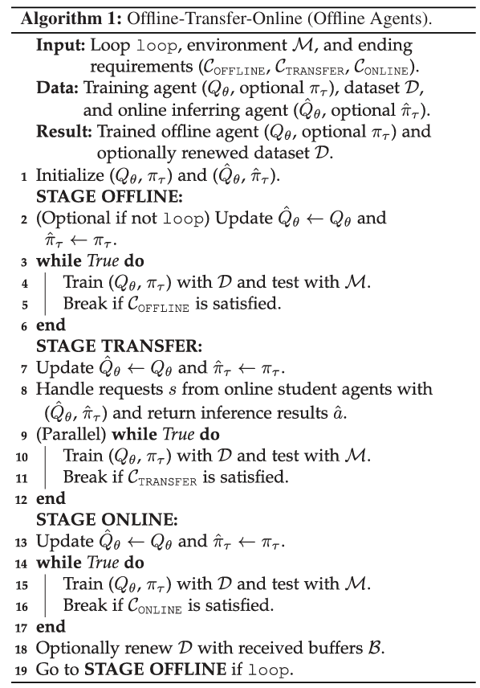
Method Design
CPS Computational Learning Laboratory

Slide 15
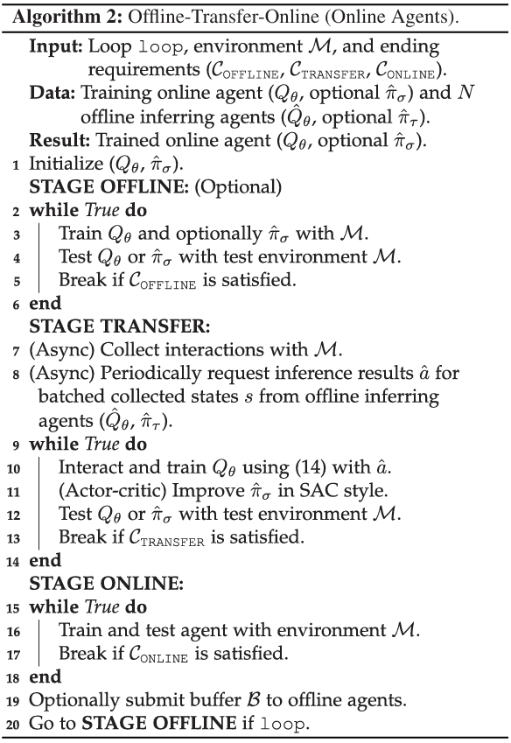
Method Design
CPS Computational Learning Laboratory

Slide 16
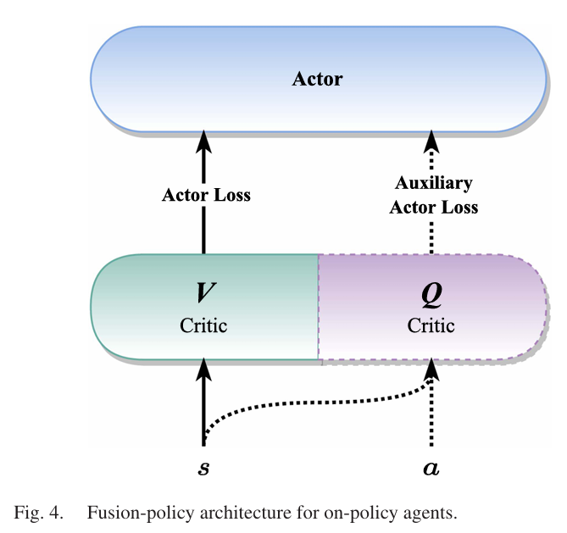
Method Design
Offline-Transfer-Online Reinforcement Learning
CPS Computational Learning Laboratory
Notes:
offline-agent使用的价值网络输出的是动作价值Q(s,a)，针对一些on-poicy(ppo)，价值网络输出的是状态价值Q(s)，提出一种融合策略方法，能够利用offline-agent的知识

Slide 17
01
Problem Description
02
Method Design
03
Experiment Results
Contents
04
Conclusion
CPS Computational Learning Laboratory

Slide 18
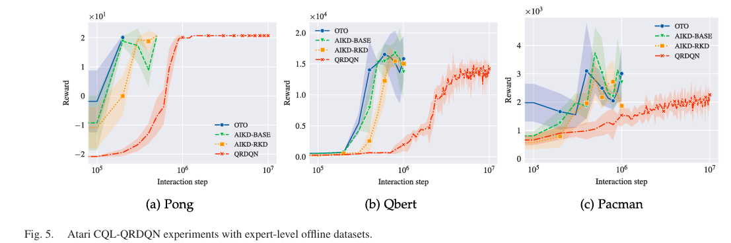
Experiment Results
Discrete Experiments: Atari (Homogeneous)
CPS Computational Learning Laboratory
Notes:
offline智能体使用专家水平离线数据集，
AIKD-BASE：损失函数采用公式10
AIKD-RKD：损失函数采用公式11
OTO算法比QRDQN快2-10倍

Slide 19
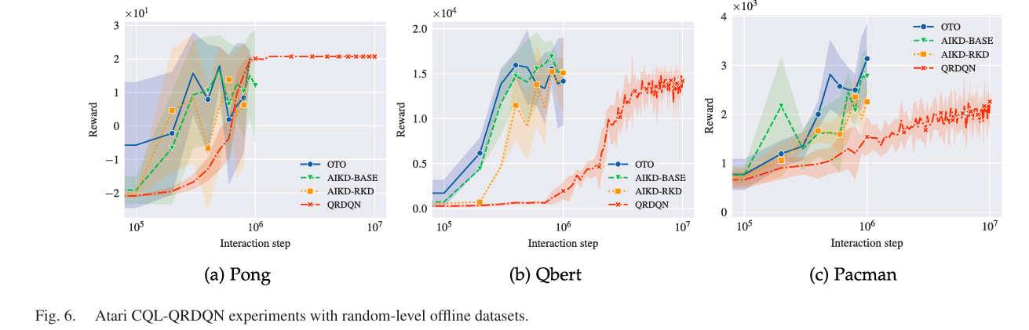
Experiment Results
Discrete Experiments: Atari (Homogeneous)
CPS Computational Learning Laboratory
Notes:
offline智能体使用随机水平离线数据集，
AIKD-BASE：损失函数采用公式10
AIKD-RKD：损失函数采用公式11
OTO算法比QRDQN快2-10倍

Slide 20
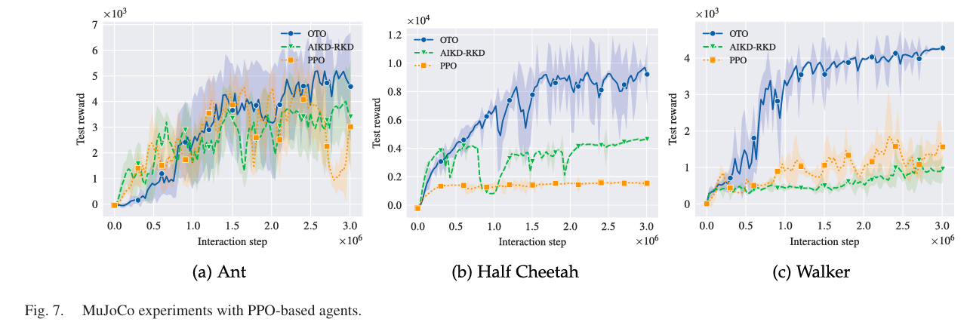
Experiment Results
Continuous Experiments: MuJoCo (Homogeneous)
CPS Computational Learning Laboratory
Notes:
证明OTO框架也适用于on-policy&online智能体，检测混合策略结构的是否有效
offline智能体采用SAC算法，online智能体采用PPO算法
AIKD-RKD：损失函数采用公式11
PPO：没有offline智能体的协助
结论OTO的能够适用on-policy&online智能体，且收敛速度快，奖励高

Slide 21
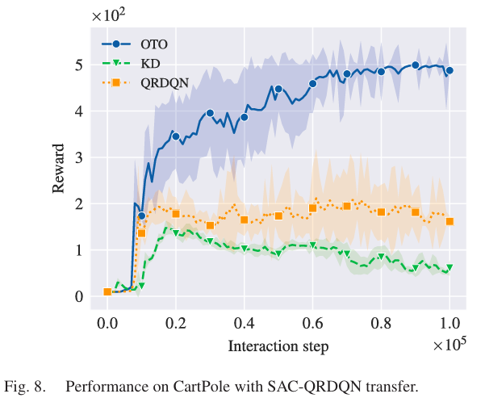
Experiment Results
CartPole Control (Heterogeneous)
Offline Agent: A continuous SAC agent trained with Inverted Pendulum as the teacher agent.
Online Agent: Discrete QRDQN agents as the student agents to train with CartPole.
CPS Computational Learning Laboratory
Notes:
KD(knowledge distillation)：一种知识蒸馏的方法
QRDQN:online智能体单独训练，没有使用迁移算法

Slide 22
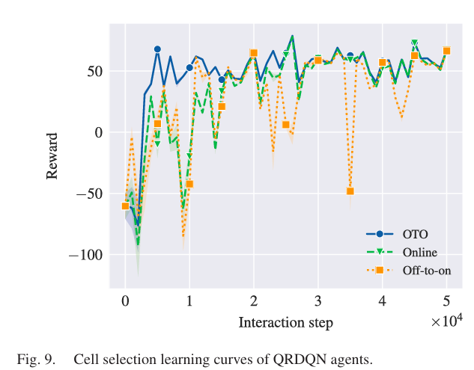
Experiment Results
CartPole Control (Heterogeneous)
OTO: A PPO agent trained with the 4G environment as the teacher agent and a QRDQN agent trained in the 5G environment as the student agent
Online: A QRDQN agent is trained with the 5G environment.
Off-to-on: A QRDQN agent is trained in 4G but tested with 5G
CPS Computational Learning Laboratory
Notes:
实验：1个移动设备选择7个基站
OTO收敛速度快

Slide 23
Experiment Results
Mobile Cell Selection (Heterogeneous)
OTO: A PPO agent trained with the 4G environment as the teacher agent and a QRDQN agent trained in the 5G environment as the student agent
Online: A QRDQN agent is trained with the 5G environment.
Off-to-on: A QRDQN agent is trained in 4G but tested with 5G
CPS Computational Learning Laboratory
Notes:
实验：1个移动设备选择7个基站
OTO收敛速度快

Slide 24
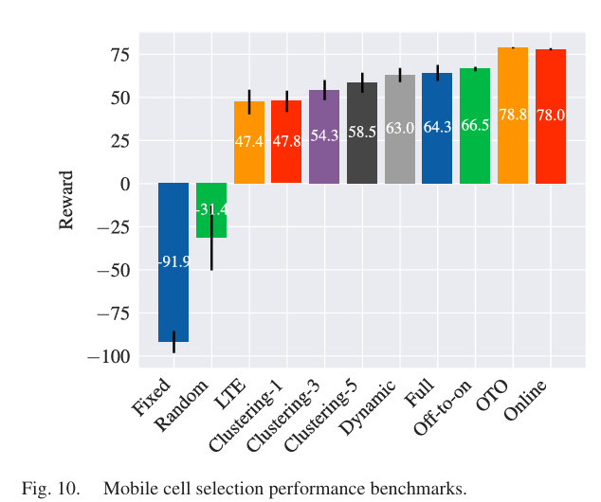
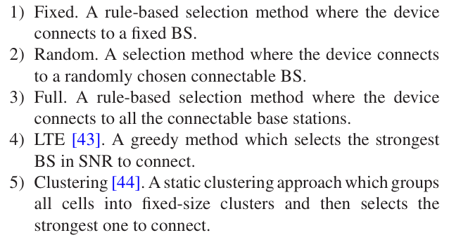
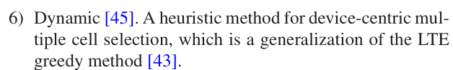
Experiment Results
Mobile Cell Selection (Heterogeneous)
CPS Computational Learning Laboratory
Notes:
实验：1个移动设备选择7个基站
OTO性能好，且稳定

Slide 25
01
Problem Description
02
Method Design
03
Experiment Results
Contents
04
Conclusion
CPS Computational Learning Laboratory
CPS Computational Learning Laboratory
2
18

Slide 26
Conclusion
We propose a novel Offline-Transfer-Online RL training method for cloud-edge collaborative RL, which bridges online and offline RL by taking advantage of our algorithm-independent knowledge distillation design through an agent-environment interaction interface
Our proposed AIKD loss function integrates the ideas of conservative learning and transferring the relationship patterns between selected actions of the offline policy to online agents.
CPS Computational Learning Laboratory

Slide 27
Paper 2
Cross-Domain Adaptive Transfer Reinforcement
Learning Based on State-Action Correspondence
Heng You, Tianpei Yang, Yan Zheng, Jianye Hao, Matthew E. Taylor
Publish Journal: The 38th Conference on Uncertainty in Artificial Intelligence (UAI)
Published Time: 2022
CPS Computational Learning Laboratory

Slide 28
01
Problem Description
02
Method Design
03
Experiment Results
Contents
04
Conclusion
CPS Computational Learning Laboratory

Slide 29
01
Problem Description
02
Method Design
03
Experiment Results
Contents
04
Conclusion
CPS Computational Learning Laboratory

Slide 30
01
Problem Description
02
Method Design
03
Experiment Results
Contents
04
Conclusion
CPS Computational Learning Laboratory

Slide 31
Method Design
This paper proposes a novel framework called Cross-domain Adaptive Transfer (CAT) to accelerate DRL
CAT learns the state-action correspondence from each source task to the target task and adaptively transfers knowledge from multiple source task policies to the target policy.
CPS Computational Learning Laboratory

Slide 32
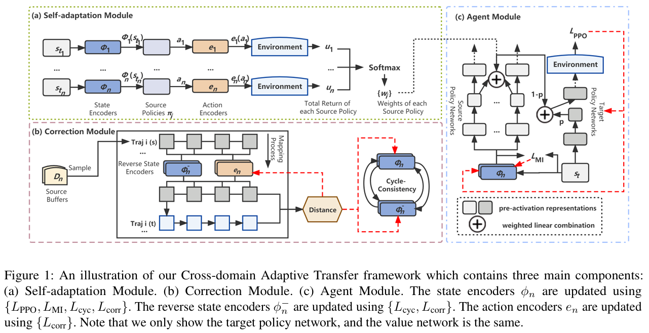
Method Design
CPS Computational Learning Laboratory

Slide 33
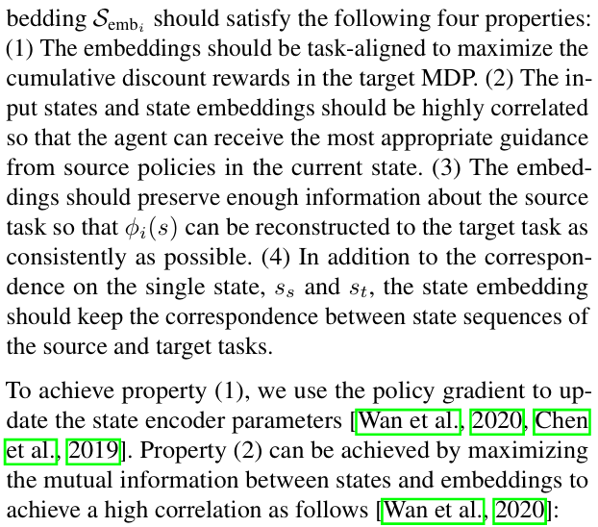
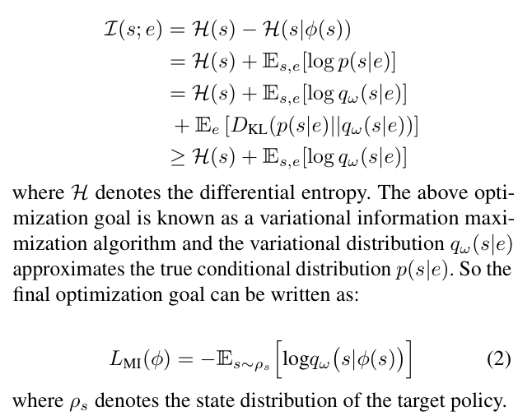
Method Design
Learning State-Action Correspondence
CPS Computational Learning Laboratory

Slide 34
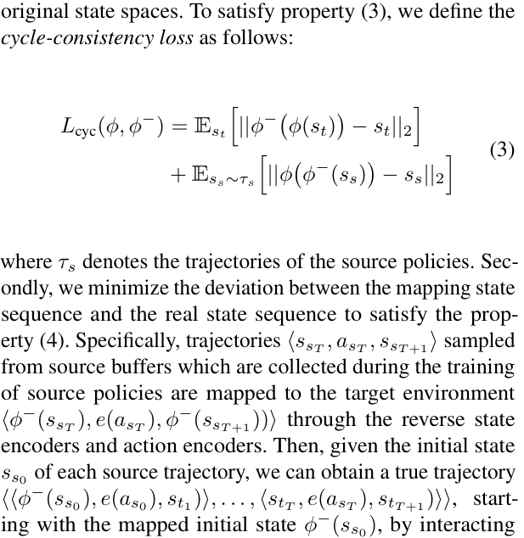
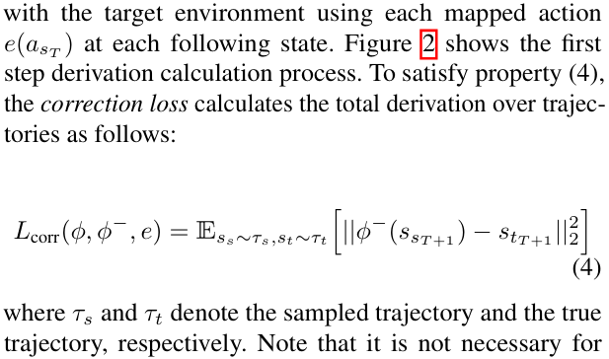
Method Design
Learning State-Action Correspondence
CPS Computational Learning Laboratory

Slide 35
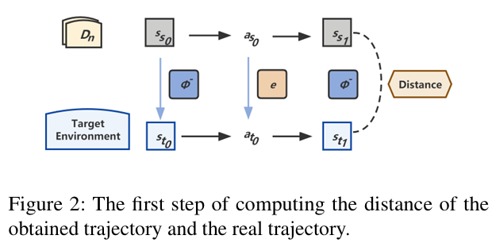
Method Design
Learning State-Action Correspondence
CPS Computational Learning Laboratory

Slide 36
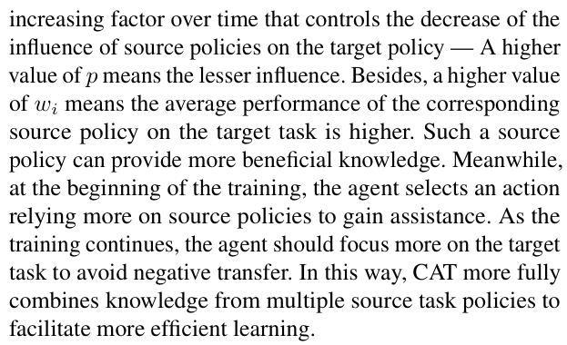
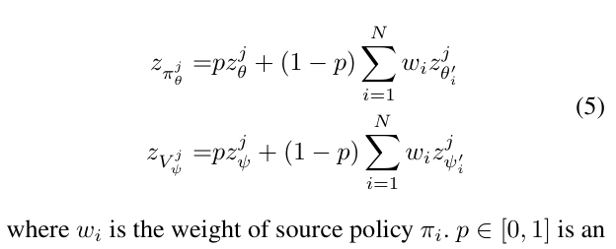
Method Design
Adaptive Policy Transfer
CPS Computational Learning Laboratory

Slide 37
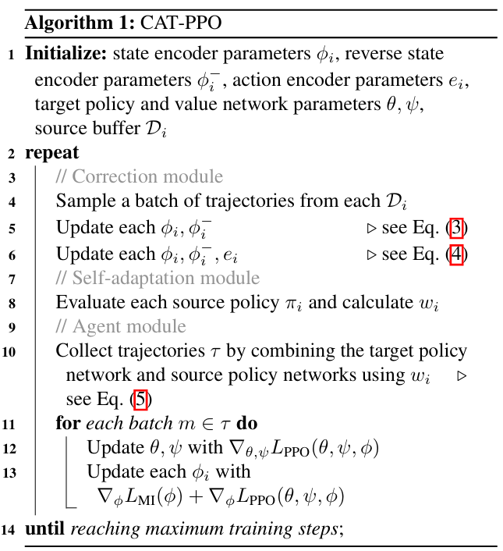
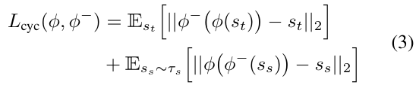
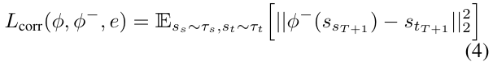
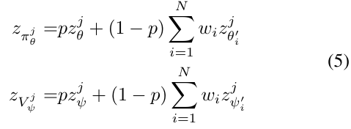
Method Design
CAT-PPO
CPS Computational Learning Laboratory

Slide 38
01
Problem Description
02
Method Design
03
Experiment Results
Contents
04
Conclusion
CPS Computational Learning Laboratory

Slide 39
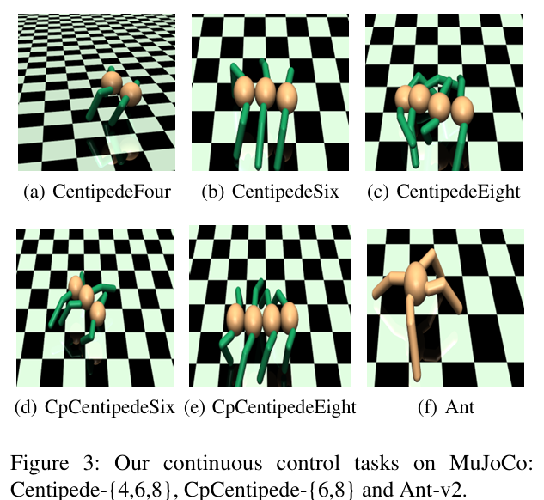
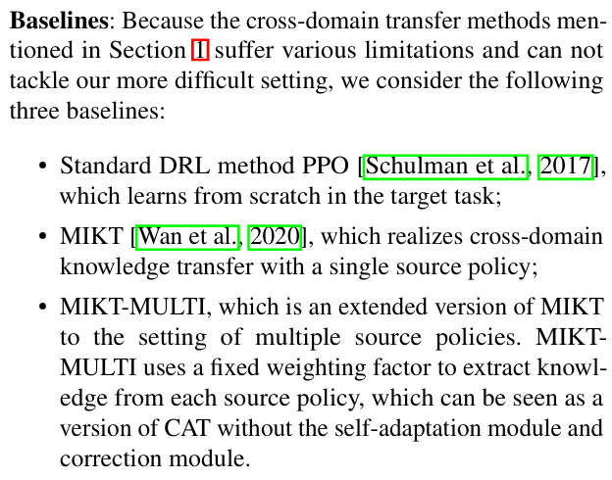
Experiment Results
Setup
CPS Computational Learning Laboratory

Slide 40
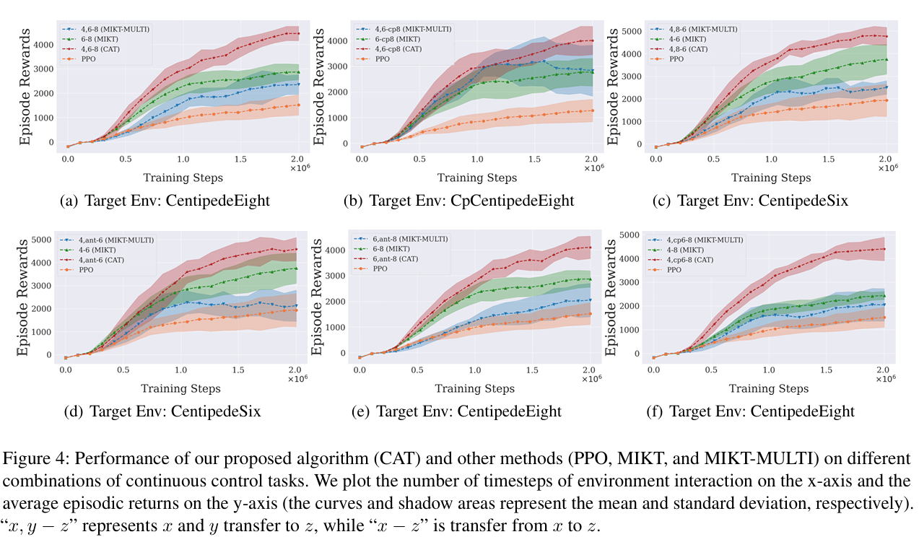
Experiment Results
CPS Computational Learning Laboratory

Slide 41
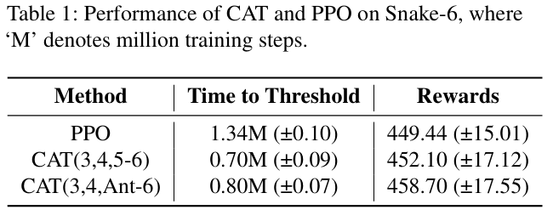
Experiment Results
CPS Computational Learning Laboratory

Slide 42
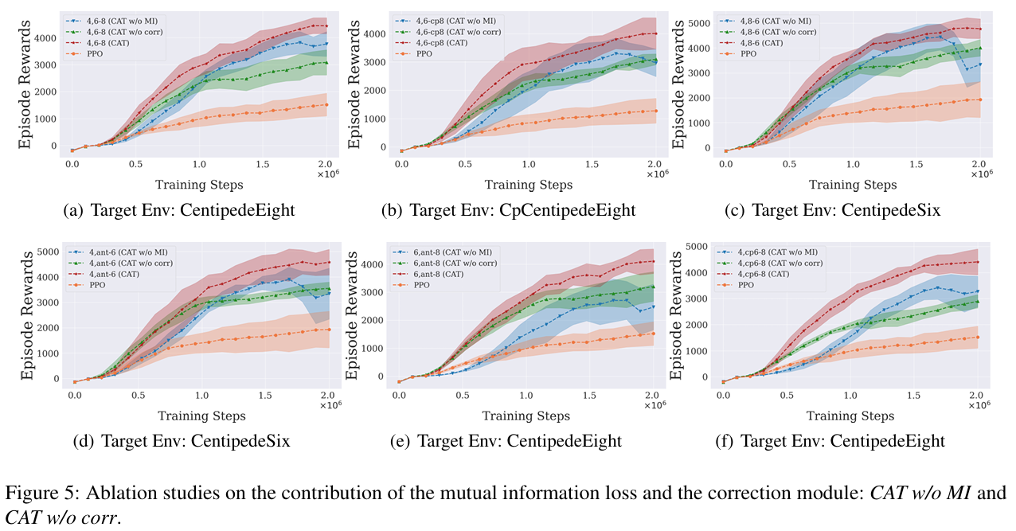
Experiment Results
Ablation Studies
CPS Computational Learning Laboratory

Slide 43
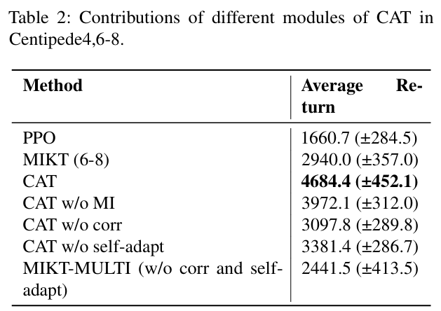
Experiment Results
Ablation Studies
CPS Computational Learning Laboratory

Slide 44
01
Problem Description
02
Method Design
03
Experiment Results
Contents
04
Conclusion
CPS Computational Learning Laboratory
CPS Computational Learning Laboratory
2
18

Slide 45
Conclusion
We firstly propose a novel framework called Cross-domain Adaptive Transfer (CAT) which adaptively transfers knowledge from multiple cross-domain policies.
We firstly propose four properties that the learned state-action correspondence should satisfy
CPS Computational Learning Laboratory

Slide 46
Paper 3
Domain Adaptation In Reinforcement Learning
Via Latent Unified State Representation
Jinwei Xing , Takashi Nagata , Kexin Chen, Xinyun Zou, Emre Neftci, Jeffrey L. Krichmar
Publish Journal: AAAI
Published Time: 2021
CPS Computational Learning Laboratory

Slide 47
01
Problem Description
02
Method Design
03
Experiment Results
Contents
04
Conclusion
CPS Computational Learning Laboratory

Slide 48
01
Problem Description
02
Method Design
03
Experiment Results
Contents
04
Conclusion
CPS Computational Learning Laboratory

Slide 49
Problem Description
Although the generalization ability of RL agents is critical for the realworld applicability of Deep RL, zero-shot policy transfer is still a challenging problem since even minor visual changes could make the trained agent completely fail in the new task.
CPS Computational Learning Laboratory

Slide 50
01
Problem Description
02
Method Design
03
Experiment Results
Contents
04
Conclusion
CPS Computational Learning Laboratory

Slide 51
Method Design
To address this issue, we propose a two-stage RL agent that first learns a latent unified state representation (LUSR) which is consistent across multiple domains in the first stage, and then do RL training in one source domain based on LUSR in the second stage.
To learn LUSR, we split the latent state representation into domain-general embedding which contains information existing in all domains and domain-specific embedding that compress domain specific information.
CPS Computational Learning Laboratory

Slide 52
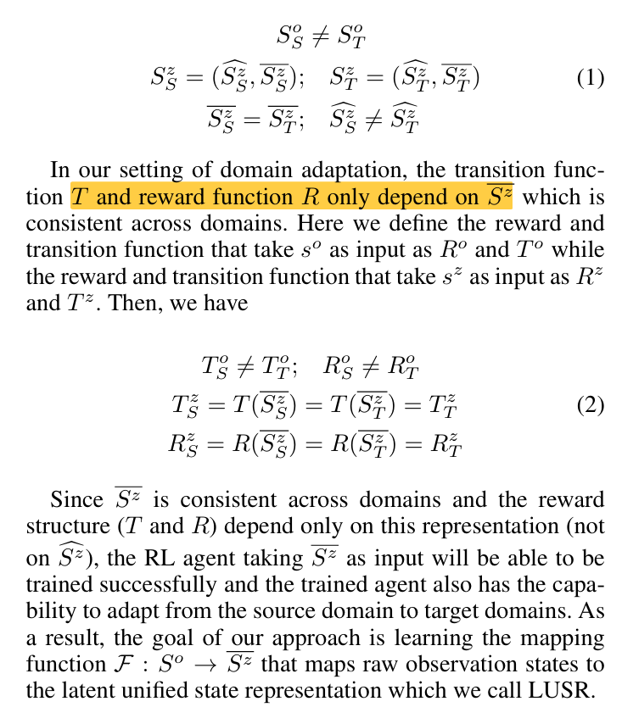
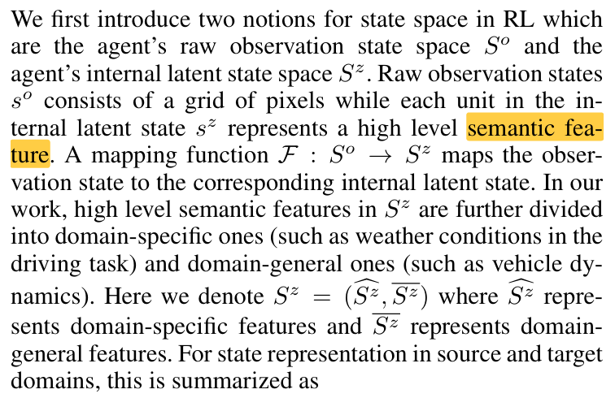
Method Design
LUSR Definition
CPS Computational Learning Laboratory

Slide 53
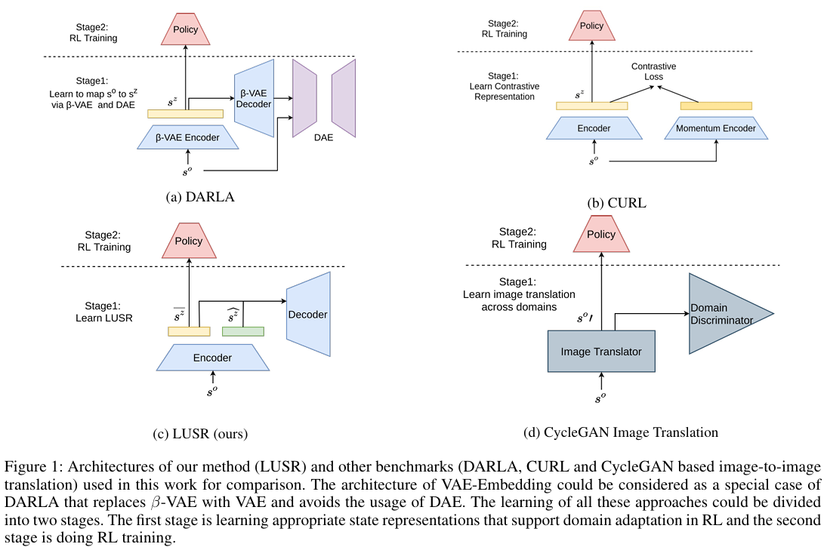
Method Design
LUSR Definition
CPS Computational Learning Laboratory

Slide 54
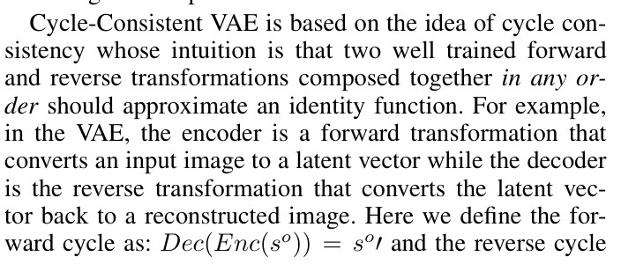
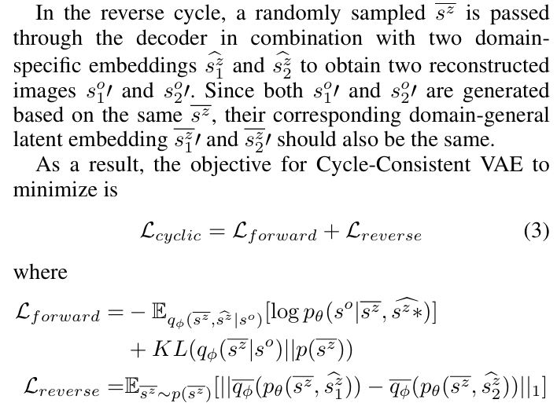
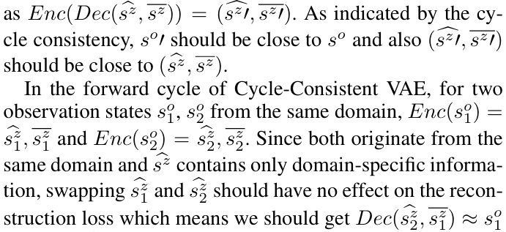
Method Design
Learning LUSR
CPS Computational Learning Laboratory

Slide 55
01
Problem Description
02
Method Design
03
Experiment Results
Contents
04
Conclusion
CPS Computational Learning Laboratory

Slide 56
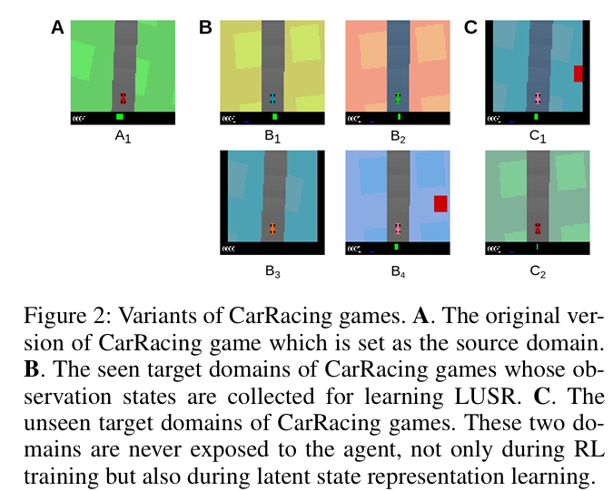
Experiment Results
Environments
CPS Computational Learning Laboratory

Slide 57
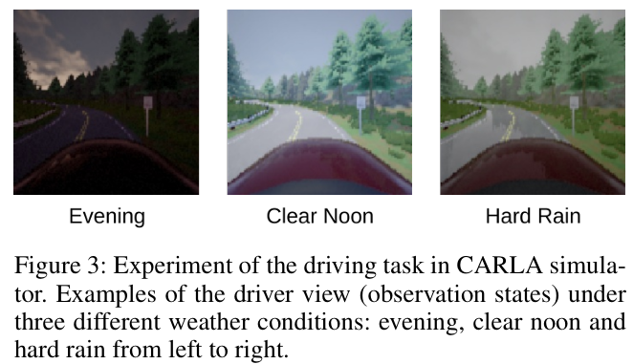
Experiment Results
Environments
CPS Computational Learning Laboratory

Slide 58
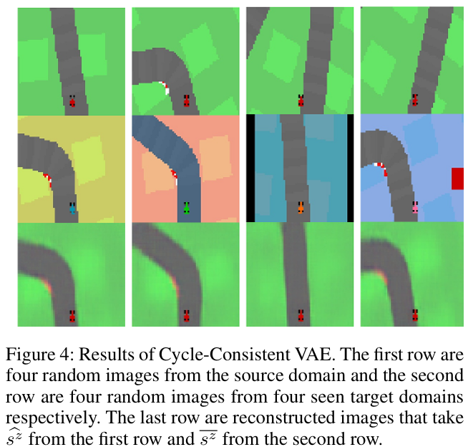
Experiment Results
LUSR Demonstration
CPS Computational Learning Laboratory

Slide 59
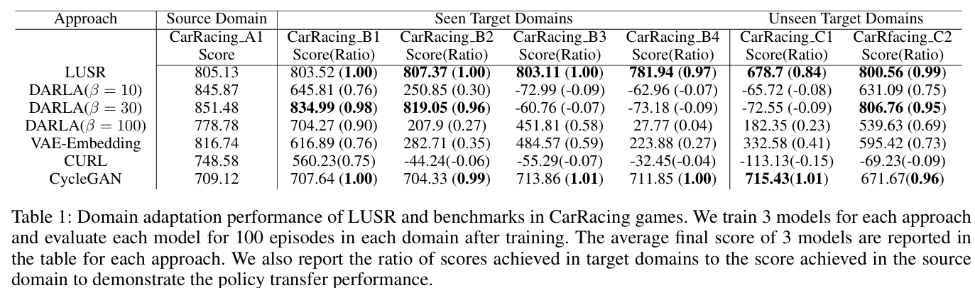
Experiment Results
Domain Adaptation After Training (CarRacing)
CPS Computational Learning Laboratory

Slide 60
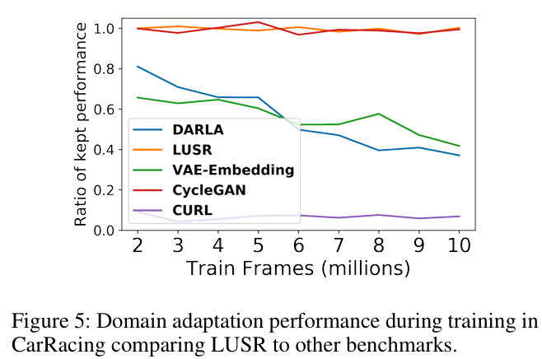
Experiment Results
Domain Adaptation During Training (CarRacing)
CPS Computational Learning Laboratory

Slide 61
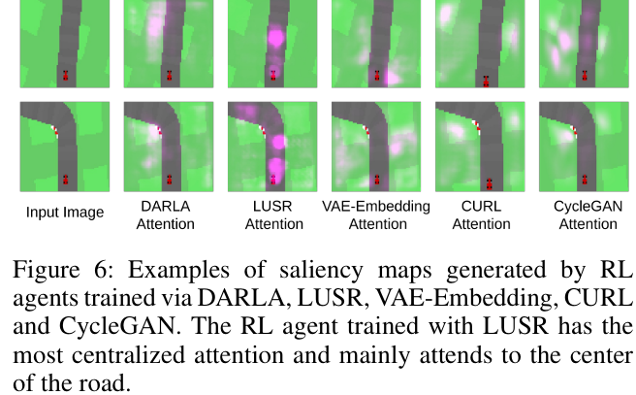
Experiment Results
Saliency Map (CarRacing)
CPS Computational Learning Laboratory

Slide 62

Experiment Results
LUSR Demonstration (Autonomous Driving In CARLA)
CPS Computational Learning Laboratory

Slide 63

Experiment Results
Domain Adaptation Performance (Autonomous Driving In CARLA)
CPS Computational Learning Laboratory

Slide 64
01
Problem Description
02
Method Design
03
Experiment Results
Contents
04
Conclusion
CPS Computational Learning Laboratory
CPS Computational Learning Laboratory
2
18

Slide 65
Conclusion
We propose to disentangle domain-general embedding and domain-specific embedding in the latent state representation of RL and theoretically formalize it in the scenario of domain adaptation.
We propose LUSR which utilizes the domain-general latent embedding as state representation and prove its efficiency in two RL tasks with different visual complexity
CPS Computational Learning Laboratory

Slide 66
Paper 4
Lateral Transfer Learning for
Multiagent Reinforcement Learning
Haobin Shi, Jingchen Li, Jiahui Mao, Kao-Shing Hwang
Published in: IEEE TRANSACTIONS ON CYBERNETICS
Published Time: 2023
CPS Computational Learning Laboratory

Slide 67
01
Problem Description
02
Method Design
03
Experiment Results
Contents
04
Conclusion
CPS Computational Learning Laboratory

Slide 68
01
Problem Description
02
Method Design
03
Experiment Results
Contents
04
Conclusion
CPS Computational Learning Laboratory

Slide 69
Problem Description
The existing works devoted to cross-task transfer for multiagent systems were designed just for homogeneous agents or similar domains.
Too few works are denoted to intraagent transfer for MARL, and these works cannot work on all-purpose cross-task scenarios.
CPS Computational Learning Laboratory

Slide 70
01
Problem Description
02
Method Design
03
Experiment Results
Contents
04
Conclusion
CPS Computational Learning Laboratory

Slide 71
Method Design
This work is the first to propose an all-purpose cross-task transfer method for MARL, developing a multiagent lateral transfer (MALT) algorithm. MALT can transfer knowledge across tasks in most settings.
The pretrained policies are mapped to the target task according to a Gaussian mixture model (GMM), which clusters pretrained policies according to the value function and assigns the policies for every agent in the target task according to the clustering result.
A soft-attention module weighs the features from different pretrained policies to improve the lateral transfer efficiency
CPS Computational Learning Laboratory
Notes:
1、针对多智能体强化学习，提出一个全场景下的跨任务迁移方法（异构、同构、竞争、协作）
2、利用GMM对源域中不同智能体的策略进行分类聚合
3、软注意力机制，在目标域中训练智能体时，对来自不同智能体策略的每个模块输出进行加权，输入到目标域策略网络中。

Slide 72


Method Design
Policy Assignment
CPS Computational Learning Laboratory
Notes:
把目标域中的策略按照状态价值进行聚类，分成n个簇
公式（2）：从源域抽取若干个状态，计算源域中每个智能体在这组状态下的状态价值
公式（3）：yi，第i个源域智能体状态价值向量
GMM：生成n个混合高斯分布，用n个高斯分布来拟合n’组数据，就是将n个智能体的数据进行聚类
公式（4）：计算每个数据在数据在每个高斯分布下的概率密度，代表第i个源域智能体的数据在第k个高斯分布下的概率密度，
乘上权重，代表第i个数据在这个混合高斯分布下的概率密度，
再相乘，代表这组数据在这个混合高斯分布下的概率密度
公式（6）：每个簇要挑选m组源域智能体数据（给每个智能体分配m个预训练的源域智能体策略），每个簇要使这个联合概率密度最大，也就是让这m组数据来自于这个簇的概率最大

Slide 73



Method Design
Attention Module
CPS Computational Learning Laboratory
Notes:
目标域智能体i，有m个源域预训练策略
输入状态s，每个策略产生一个输出一个动作，经过一个独立的线性层，再经过一个全连接层U和softmax层，输出加权系数（m个源域策略和目标域智能体i的关系）

Slide 74


Method Design
Lateral Connection With Attention Module
CPS Computational Learning Laboratory
Notes:
图3：策略网络是模块化的，可以保证在横向迁移的过程中，不影响源域策略网络的状态表征
图4：目标域智能体i被分配了3个源域智能体（策略），比如每个源域策略第j个模块的输出会按照注意力权重进行加权，然后加上目标域智能体在第j个模块的输出，作为目标域智能体在第j+1个模块的输出
完成多个源域任务的横向知识迁移

Slide 75



Method Design
CPS Computational Learning Laboratory

Slide 76
01
Problem Description
02
Method Design
03
Experiment Results
Contents
04
Conclusion
CPS Computational Learning Laboratory

Slide 77


Experiment Results
Setups
CPS Computational Learning Laboratory
Notes:
CTC：源环境和目标环境差不多，所以Finetue、FullyFinetune和MALT性能差不多
RT：源环境的任务和目标环境的任务差别比较大，可以看到MALT性能显著好
这个实现因为是相同的域，GMM聚类看不出效果，Atttention模块效果改善比较明显

Slide 78


Experiment Results
Same Domain
CPS Computational Learning Laboratory
Notes:
Same Domain：源域和目标域任务目标不同，其他都一样
CTC环境：猎人（小灰圈）寻找宝藏（小蓝圈、小橙圈），并存入指定颜色的银行（大灰圈）
源域和目标域区别是猎人要把宝藏存入不同颜色的银行
RT环境：speaker（小灰圈）告诉listener（大灰圈）信息，并移动到目的地（紫色、绿色、棕色的小圈）
源域是listener移动到目的地，目标域是listener移动到speaker旁边

Slide 79


Experiment Results
Same Domain
CPS Computational Learning Laboratory
Notes:
CTC：源环境和目标环境差不多，所以Finetue、FullyFinetune和MALT性能差不多
RT：源环境的任务和目标环境的任务差别比较大，可以看到MALT性能显著好
这个实现因为是相同的域，GMM聚类看不出效果，Atttention模块效果改善比较明显

Slide 80



Experiment Results
Same Domain
CPS Computational Learning Laboratory
Notes:
加权注意力值，每个源策略对目标域中每个智能体的重要性程度

Slide 81

Experiment Results
Similar Domains
CPS Computational Learning Laboratory
Notes:
无人机监测任务：红色是人，绿色是树，黑色是墙，无人机在其视野范围内能够监测更多的人
源域：地图大小是100，无人机数量是7，无人机视野范围是10，人的数量是9
目标域：地图大小是50，无人机数量是4，无人机视野范围是10，人的数量是5
Similar Domains：源域和目标域区别是联合观测空间和联合动作空间的维度不同，但是任务目标都一样

Slide 82

Experiment Results
Similar Domains
CPS Computational Learning Laboratory
Notes:
因为源域和目标域任务目标相同，所以finetune方法开始有比较好的性能
GMM和Attention模块让奖励增长得更稳定

Slide 83




Experiment Results
Similar Domains
CPS Computational Learning Laboratory
Notes:
不同源域策略对目标域智能体的重要程度

Slide 84

Experiment Results
Different Domains
CPS Computational Learning Laboratory

Slide 85

Experiment Results
Different Domains
CPS Computational Learning Laboratory
Notes:
源域任务和目标域任务完全不同，检测MALT是否有负迁移现象。
在前两个场景下，MALT正迁移，效果好。但在第三个场景下出现了负迁移。

Slide 86


Experiment Results
Comparison Experiment——Fully Similar Transfer
CPS Computational Learning Laboratory
Notes:
和一些方法的对比实验，用的是一个机器人足球环境，一方负责控球，另一方负责抢球。
主干网络使用的是DQN，
源域：5个控球，5个抢球
目标域：4个控球，6个抢球

Slide 87

Experiment Results
Comparison Experiment——Currculum Learning
CPS Computational Learning Laboratory
Notes:
目标和捕食者，任务难度逐渐提高

Slide 88


Experiment Results
Comparison Experiment——Currculum Learning
CPS Computational Learning Laboratory
Notes:
课程学习的核心思想是：在训练模型时，不直接将所有复杂的数据或任务一下子都给模型，而是先从相对简单的样本或任务开始训练，当模型在简单任务上达到一定表现后，再逐步增加难度，引入更复杂的样本或任务。
MALT对比一些课程学习方法，也有很好的迁移效果。

Slide 89
01
Problem Description
02
Method Design
03
Experiment Results
Contents
04
Conclusion
CPS Computational Learning Laboratory
CPS Computational Learning Laboratory
2
18

Slide 90
Conclusion
This work proposes a transfer learning algorithm, MALT, which is the first method to achieve all-purpose cross-task transfer for MARL.
The proposed MALT allows agents to learn new features while reusing pretrained features, so that it hardly causes negative transfer in different domains.
CPS Computational Learning Laboratory

Slide 91
Paper 5
Reinforcement Learning With Adaptive Policy
Gradient Transfer Across Heterogeneous Problems
Gengzhi Zhang, Liang Feng, Yu Wang, Min Li, Hong Xie, Kay Chen Tan
Publish Journal:IEEE TRANSACTIONS ON EMERGING TOPICS IN COMPUTATIONAL INTELLIGENCE
Published Time: 2024
CPS Computational Learning Laboratory

Slide 92
01
Problem Description
02
Method Design
03
Experiment Results
Contents
04
Conclusion
CPS Computational Learning Laboratory

Slide 93
01
Problem Description
02
Method Design
03
Experiment Results
Contents
04
Conclusion
CPS Computational Learning Laboratory

Slide 94
Problem Description
Most of the existing TRL approaches consider knowledge transfer between RL tasks sharing the same state-action space. These methods thus may fail in cases where the RL tasks available for conducting knowledge transfer possess heterogeneous state-action spaces
This becomes more difficult if multiple heterogeneous source tasks area vailable when conducting knowledge transfer for a target RL task, as we have to identify the appropriate source task adaptively before performing knowledge transfer.
CPS Computational Learning Laboratory

Slide 95
01
Problem Description
02
Method Design
03
Experiment Results
Contents
04
Conclusion
CPS Computational Learning Laboratory

Slide 96
Method Design
We propose a new TRL algorithm with adaptive policy gradient transfer for the cases having multiple heterogeneous source RL tasks.
The core ingredients of the proposed algorithm contain a source task selection module to select an appropriate task from a set of heterogeneous source tasks and a knowledge transfer module for conducting knowledge transfer across heterogeneous RL tasks.
CPS Computational Learning Laboratory

Slide 97

Method Design
Outline of the Proposed TRL Algorithm
CPS Computational Learning Laboratory

Slide 98

Method Design
Outline of the Proposed TRL Algorithm
CPS Computational Learning Laboratory

Slide 99


Method Design
Source Task Selection Module
CPS Computational Learning Laboratory

Slide 100

Method Design
Source Task Selection Module
CPS Computational Learning Laboratory

Slide 101

Method Design
Source Task Selection Module
CPS Computational Learning Laboratory

Slide 102


Method Design
Knowledge Transfer Module
CPS Computational Learning Laboratory

Slide 103


Method Design
Knowledge Transfer Module
CPS Computational Learning Laboratory

Slide 104
01
Problem Description
02
Method Design
03
Experiment Results
Contents
04
Conclusion
CPS Computational Learning Laboratory

Slide 105


Experiment Results
Setup
CPS Computational Learning Laboratory

Slide 106

Experiment Results
TRL Across the Reacher Tasks
CPS Computational Learning Laboratory

Slide 107

Experiment Results
TRL Across the Reacher Tasks
CPS Computational Learning Laboratory

Slide 108

Experiment Results
TRL Across the Reacher Tasks
CPS Computational Learning Laboratory

Slide 109

Experiment Results
TRL Across the Reacher Tasks
CPS Computational Learning Laboratory

Slide 110

Experiment Results
TRL Across the Reacher Tasks
CPS Computational Learning Laboratory

Slide 111

Experiment Results
TRL Across the Reacher Tasks
CPS Computational Learning Laboratory

Slide 112

Experiment Results
TRL Across the Reacher Tasks
CPS Computational Learning Laboratory

Slide 113

Experiment Results
TRL Across the Reacher Tasks
CPS Computational Learning Laboratory

Slide 114

Experiment Results
TRL Across the Reacher Tasks
CPS Computational Learning Laboratory

Slide 115

Experiment Results
TRL Across the Reacher and Insert Tasks
CPS Computational Learning Laboratory

Slide 116

Experiment Results
TRL Across the Reacher and Insert Tasks
CPS Computational Learning Laboratory

Slide 117

Experiment Results
TRL Across the Reacher and Insert Tasks
CPS Computational Learning Laboratory

Slide 118

Experiment Results
TRL Across the Reacher and Insert Tasks
CPS Computational Learning Laboratory

Slide 119

Experiment Results
TRL Across the Reacher and Insert Tasks
CPS Computational Learning Laboratory

Slide 120

Experiment Results
TRL Across the Reacher and Insert Tasks
CPS Computational Learning Laboratory

Slide 121

Experiment Results
TRL Across the Reacher and Insert Tasks
CPS Computational Learning Laboratory

Slide 122

Experiment Results
TRL Across the Reacher and Insert Tasks
CPS Computational Learning Laboratory

Slide 123

Experiment Results
TRL Across the Reacher and Insert Tasks
CPS Computational Learning Laboratory

Slide 124
01
Problem Description
02
Method Design
03
Experiment Results
Contents
04
Conclusion
CPS Computational Learning Laboratory
CPS Computational Learning Laboratory
2
18

Slide 125
Conclusion
We have proposed a new heterogeneous TRL algorithm with adaptive policy gradient transfer.
In particular, the proposed method includes two modules. One is the source task selection module, which is responsible to select the useful source tasks from multiple heterogeneous source tasks. The other is the knowledge transfer module, which transfers knowledge from the selected source task to a heterogeneous target task to accelerate the learning process of the RL agent.
CPS Computational Learning Laboratory

Slide 126
Learning Action Distribution, State -Action correspondence and Latent State Representation are simple and efficient knowledge transfer methods, which transfer knowledge from source domain to target domain while preserving specific information in target domain.
CPS Computational Learning Laboratory

Slide 127
Thank you for listening

